Slide 1


Design and Implementation of a University Campus Network Using Cisco Packet Design Tracer
This work proposes designing and simulating a highly secure, scalable, and efficient network architecture for a University Campus scenario using Cisco Packet Tracer.
by Kunal Pant

Slide 2

Introduction to Network Design
1
Network Dependency
Modern organizations rely on strong networks for communication and data exchange.
2
Simulation Goals
This report uses three simulations for real-world network understanding.
3
Key Learnings
Simulations teach layered design, traffic routing, and segmentation benefits.

Slide 3
Related Work and Foundational Practices
Modular Architecture
Dynamic Routing
Studies highlight modular designs for scalability, performance, and fault isolation.
OSPF and EIGRP support scalable communication across large networks.
VLANs for Segmentation
Cisco Packet Tracer
VLANs logically segment traffic, enhancing security and minimizing broadcast domains.
It bridges theory and practice, preparing students for certifications like CCNA.

Slide 4




System Architecture Overview
Access Layer
Cisco Catalyst 2960-24TT switches connect end-user devices.
Departments have unique VLANs and subnets (e.g., VLAN 10 for Management).
Distribution Layer
Cisco Catalyst 3650-24PS switches and 2911 routers handle inter-VLAN routing.
Central router connects Star, Ring, and Tree LANs.
Core Layer
Cisco Catalyst 3850-24PS and 2911 routers form the network's basis.
Offers 10 Gbps links, centralized services, and redundant links.

Slide 5

Implementation Details
Router Configuration
Static routing or OSPF for inter-building communication.
VLAN & Port Assignments
Dedicated VLANs for departments; 802.1Q trunking.
DHCP Configuration
Dynamic IP assignment from core router DHCP pools.
SSH & Port Security
SSH for secure remote management; port security restricts MAC addresses.
ACL Implementation
ACLs control traffic between VLANs and secure services.

Slide 6

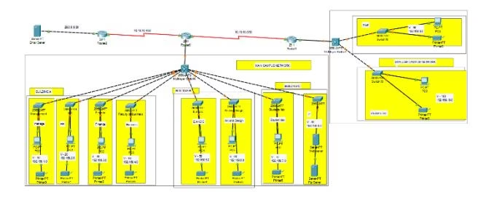
Experimental Results and Evaluation
The simulation used Cisco Packet Tracer v8.2.0 with various Cisco devices.
Connectivity tests verified intra-VLAN, inter-VLAN, and inter-building communication.
Security validation confirmed SSH access and ACL effectiveness.
DHCP functionality and server access were successfully verified.

Slide 7
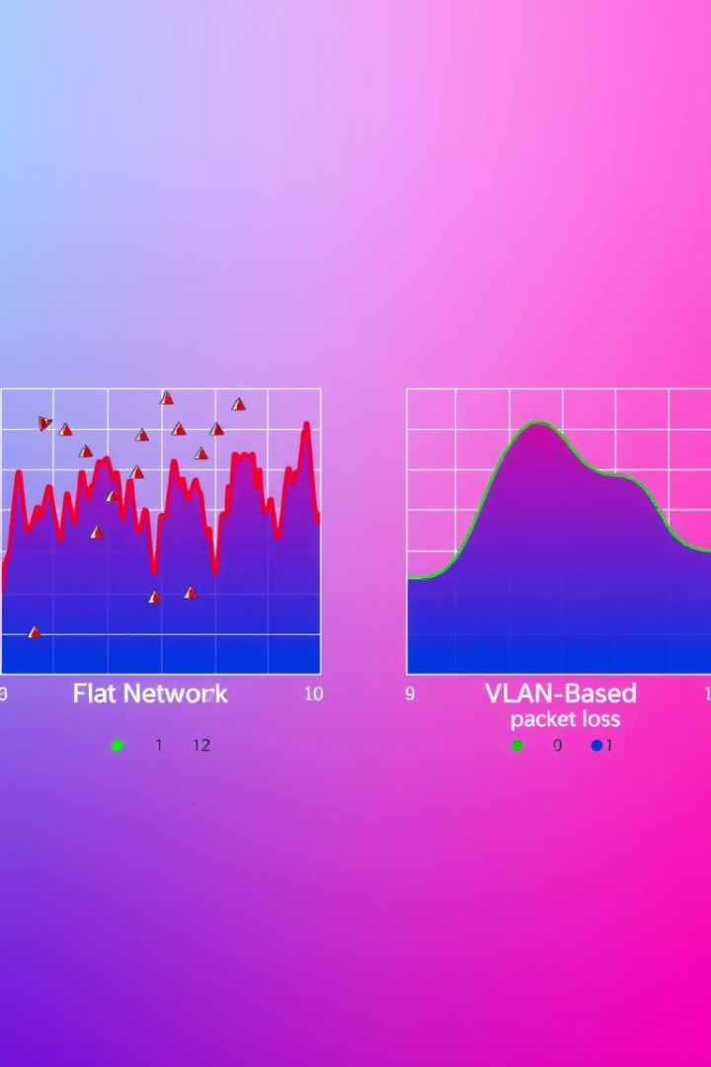
Performance Comparison
The VLAN-based model outperformed a flat network.
Guest/Admin Isolation
No
Yes
Dynamic IP Allocation
Poor
DHCP-enabled
Routing Efficiency
Poor
OSPF-based
Security via ACLs/SSH
Not present
Implemented
Central Services
Limited
Fully Integrated

Slide 8

Website Development Details
Next.js Framework
Optimised Performance
Our website is built using Next.js. This robust React framework ensures a powerful foundation.
Server-Side Rendering (SSR) and Static Site Generation (SSG) deliver lightning-fast loading speeds.
Streamlined Features
Scalable Design
Integrated routing and API routes simplify content management and dynamic functionalities.
The architecture supports future growth. It handles increasing content and user traffic efficiently.

Slide 9

Conclusion
Effective Design
Project illustrated modular network infrastructure design and testing.
Key Features
Hierarchical design, VLANs, inter-VLAN routing, centralized DHCP, and servers.
Enhanced Security
ACLs, SSH, and port security improved network security posture.
Validation
Experimental testing confirmed design correctness, effectiveness, and reliability.

Slide 10

Future Work
Future work could explore advanced routing protocols and wireless network integration. Further research into network automation and software-defined networking (SDN) would also be beneficial.

Slide 11

References
A. Smith, "Designing Scalable Campus Networks," IEEE Communications, vol. 59, no. 4, pp. 112–118, 2021.
J. Lee, "VLAN Implementation in Simulated Environments," International Journal of Networking, vol. 8, no. 2, pp. 45–52, 202.

